Slide 1
Broadcast Technology UG1
2: Electronics for Broadcast – Review
Jerry Foss
jeremy.foss@bcu.ac.uk
shielding, ground
coax
impedance
characteristic impedance

Slide 2
Earth, Chassis, etc
Circuit Interconnects, Interference
Shielding
Grounding/Earthing
Unbalanced Connections
Ground Loops
Twisted Pair Cable
Balanced Lines
Balanced Connectors
Unbalanced-To- Balanced
Balanced -To- Unbalanced
Phantom Power
Line Level
Multistages
Impedance
Characteristic Impedance

Slide 3
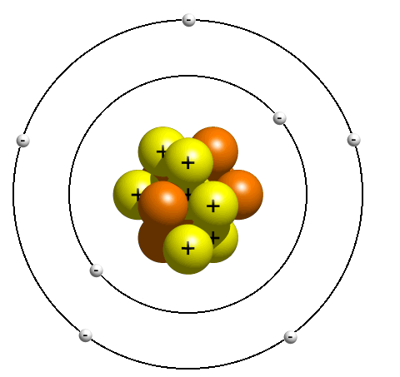
Conduction
Movement of electrons in ONE direction gives rise to ELECTRIC current
... is really a movement of CHARGE
No field – haphazard movement
... net current flow is zero
Conductors (metals, e.g. Copper) – have loose bindings to their outer electrons
-
-
-
electrons progress through conducting medium attracted towards positive electrode of the electric field.
they may be attracted to a nearby positive ion, or may continue drifting towards the anode

Slide 4
Conductors
CONDUCTORS
allow electrons to flow
electrons easily freed and move through lattice of atoms when electric field is applied
e.g. – gold, copper, tin, carbon
electron flow
-
-
-
INSULATORS
restrict movement of electrons
electrons firmly bound to atom
current flow

Slide 5
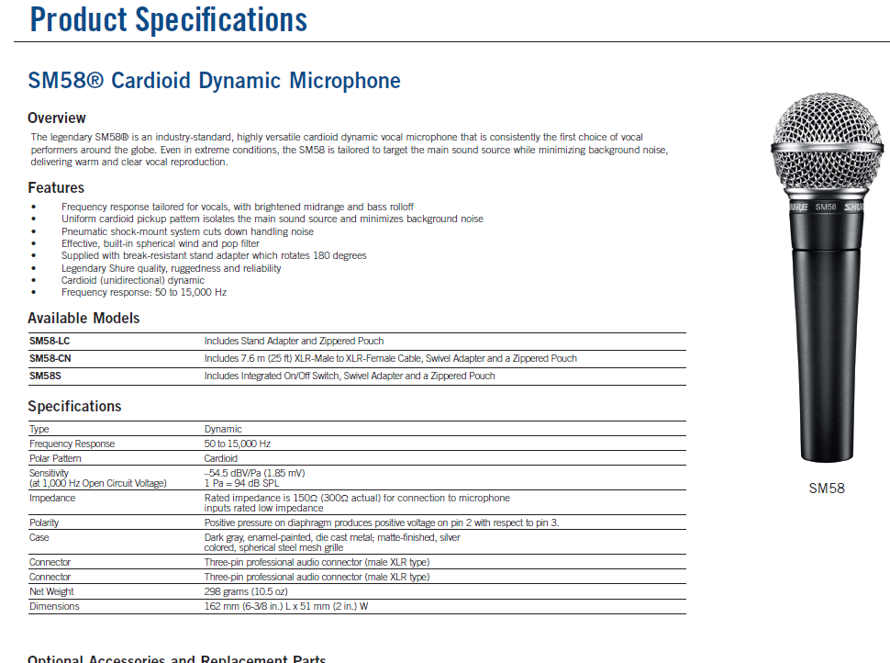
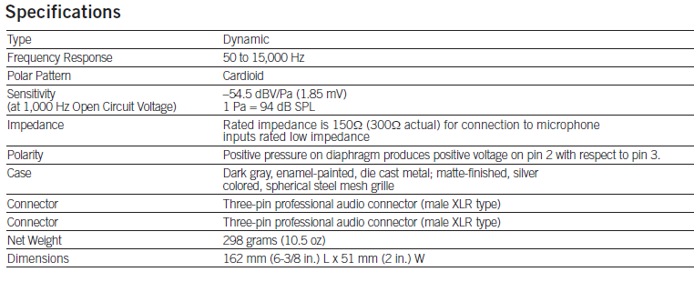
Shure SM58 Specifications
http://www.shure.com/idc/groups/public/documents/webcontent/us_pro_sm58_specsheet.pdf
Output voltage ~ 0.19mV =

Slide 6
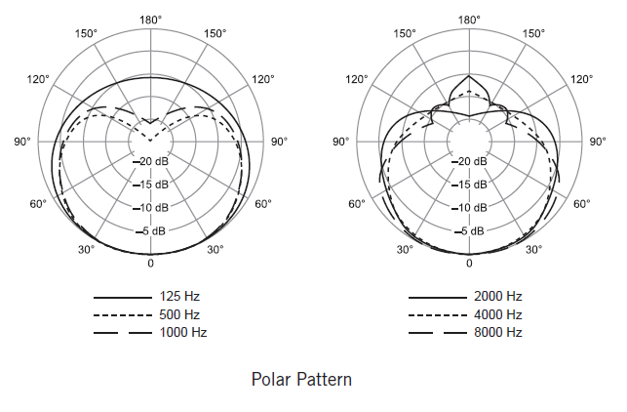
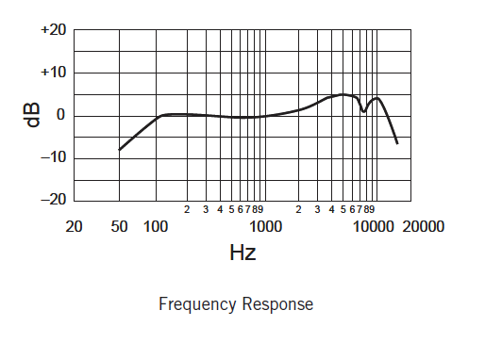
Shure SM58 Specifications
http://www.shure.com/idc/groups/public/documents/webcontent/us_pro_sm58_specsheet.pdf

Slide 7
Dynamic Microphones
sound in
signal out
Next Stage:
Preamplifier, Mixer, etc
cable: several metres
Signal voltage
Voltage difference between the two wires
0 volts

Slide 8
Interference Affects the Signal
interference
- airborne
– various sources
sound in
signal out
– distorted by interference
Next Stage:
Preamplifier, Mixer, etc
cable: several metres
Signal voltage
Note – noise often affecting both conductors
0 volts

Slide 9
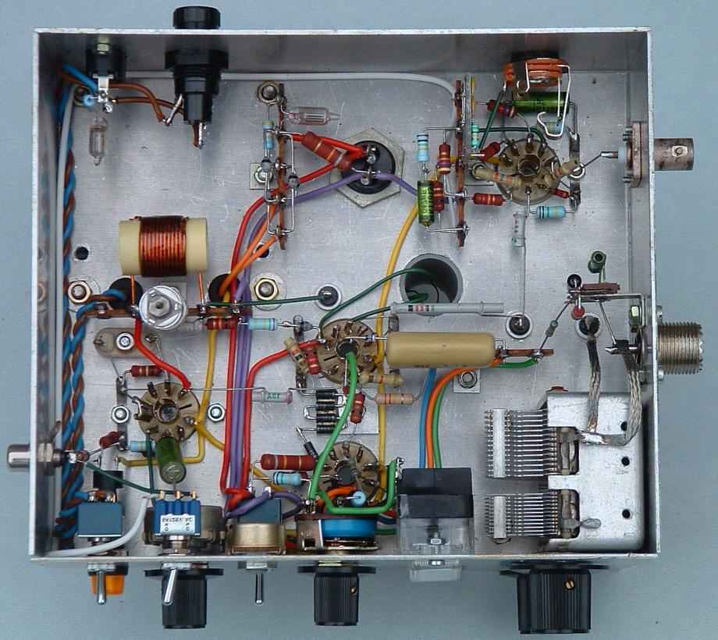
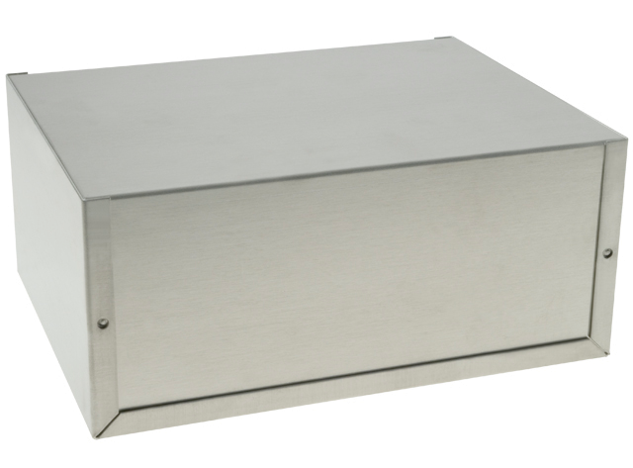
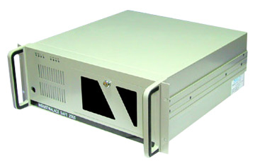
Chassis
box to contain and surround circuit
electrically conductive
protects from external interference
needs chassis to be connected to a common zero volts level, or even earth

Slide 10
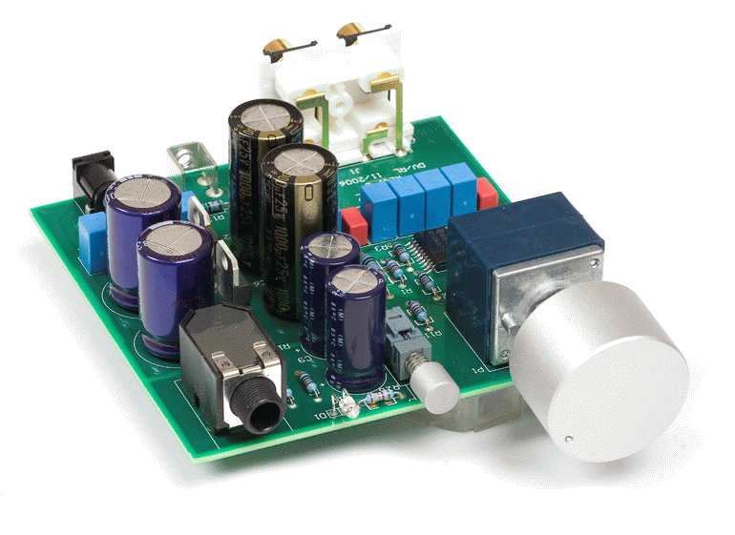
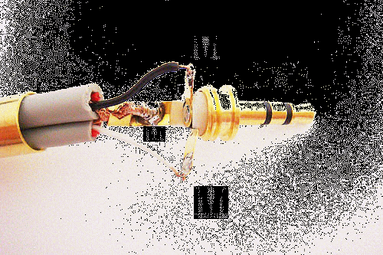
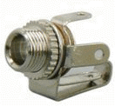
Chassis
In
0V
Out
0V
0V
0V
Chassis – is connected to all 0V points in the circuit as a “common rail”

Slide 11
Earth
In
Out
0V
0V
0V
live
earth
neutral

Slide 12
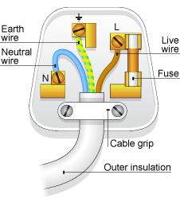
Mains Plug Wiring
In
Out
0V
0V
0V
live
earth
neutral

Slide 13
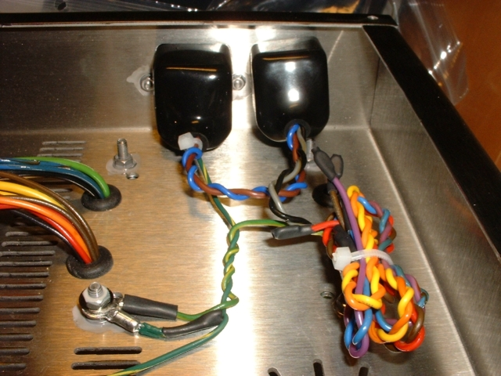
Earth, Chassis
Earth connection

Slide 14
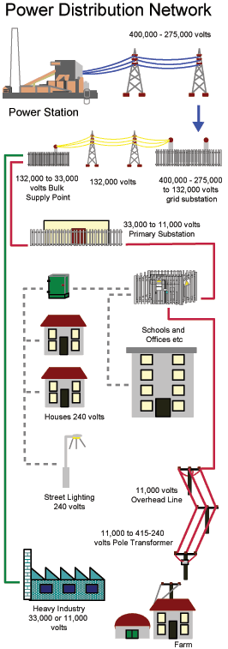
Power Distribution, using AC

Slide 15
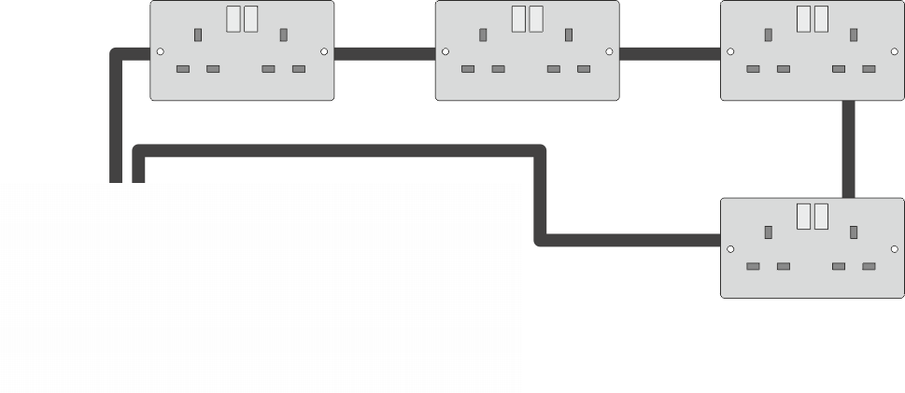
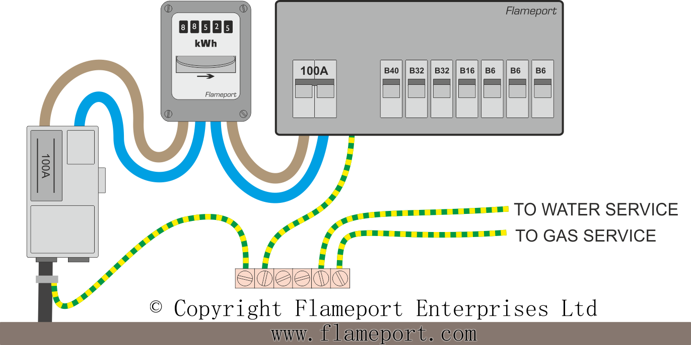
Electric Supply
live
live, neutral and earth
earth
neutral
230V supply from electrical distribution network – live and neutral
distributed from consumer unit (fuse board)
a number of circuits throughout the premises
fused at different current ratings for ring main (pictured), lighting, heating, etc
earth connected locally

Slide 16
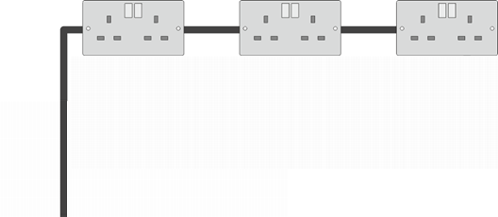
Electric Supply
radial circuit
ring circuit (preferred for wall sockets)

Slide 17
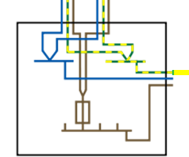
Electric Supply

Slide 18
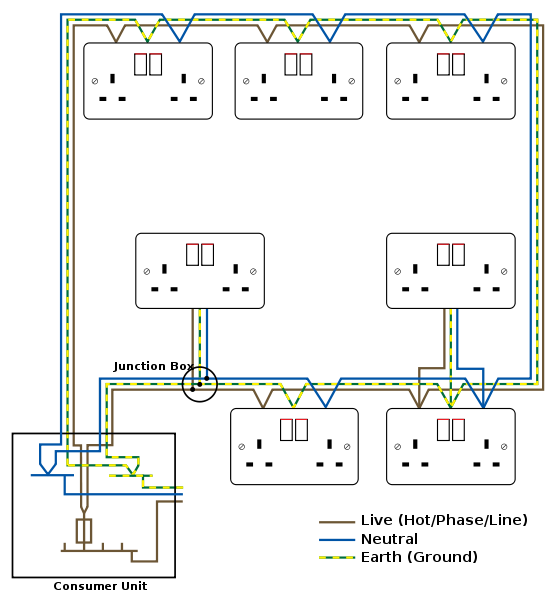
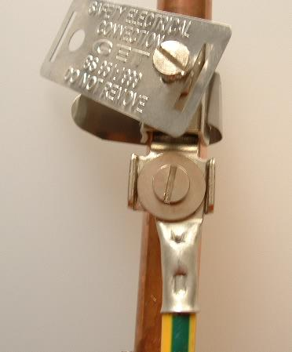
House Ring Main Wiring
Earth is locally connected to suitable earth point, typically a water pipe, or an earth spike
“spur”

Slide 19

House Ring Main Wiring
Earth is big (!) and a sufficient conductor to be a central point of reference for electrical potential

Slide 20
Circuits - Input and Outputs
V_{CC}
C₁
R₁
D
input
(Amplifier Circuit – the circuit details aren’t important)
G
C₂
S
output
R₂
R₃
R_{LOAD}
0V
The output of the circuit varies with the input signal. If one terminal is held at 0V, the output varies by the amplification of the circuit (i.e. input x Gain)
If one side of the mic coil is held at 0V, the other side of the coil is at whatever voltage is generated by the input sound; typically fraction of a volt
Zero Volts (could be Earth, maybe not)

Slide 21
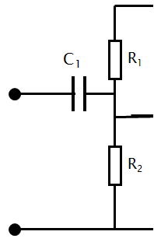
Circuits - Interference
V_{CC}
C₁
R₁
D
input
G
C₂
S
R₂
R₃
R_{LOAD}
0V
However, all parts of a circuit are susceptible to interference
(including interconnects, cables)
0V

Slide 22
Circuits – Shielding and Interconnects
V_{CC}
C₁
R₁
D
input
G
C₂
S
R₂
R₃
R_{LOAD}
0V
The shield is metallic, and fixed to the (zero) reference voltage of the circuit, usually 0V
Circuits can be easily housed in metal cases, but cables present a problem (due to their required flexibility) …
So all circuitry and interconnects should be shielded to reduce interference
0V

Slide 23
Circuits - Shielding
V_{CC}
C₁
R₁
D
input
G
C₂
S
R₂
R₃
R_{LOAD}
0V
Shielded cases for circuits; case is electrically connected to the reference point of the circuit (usually 0V)
0V

Slide 24
Circuits – Shielding Interconnects
V_{CC}
C₁
R₁
D
input
G
C₂
S
R₂
R₃
R_{LOAD}
0V
Interconnects are shielded cable, the shield surrounds the signal wire, and is connected at the plug to the circuit shield
0V

Slide 25
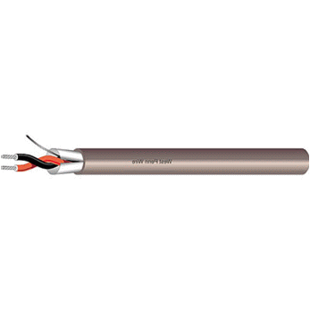
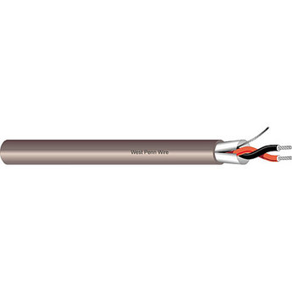
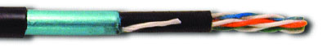
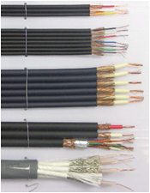
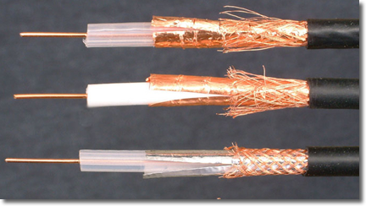
Circuits – Shielding Interconnects
One or more signal wires
metallic shield (often a mesh) surrounding the signals, connected at plug via a wire running the length of the cable
This still allows signal wires to interfere with each other, so the signals may be individually shielded
For radio frequencies, coax cable is required – shield has special resistive properties (see later)

Slide 26
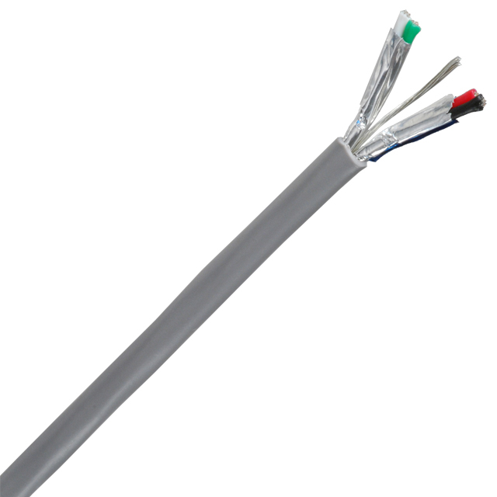

Grounded Shielding
Urually shields are grounded i.e. connected to Earth
Earth is an absolute 0V (compared to all other electrical activity on the earth, e.g. electronic circuits, natural phenomena, lightening, etc)
An earth shield provides protection
Shown here – a four signal lead with individual shielding

Slide 27
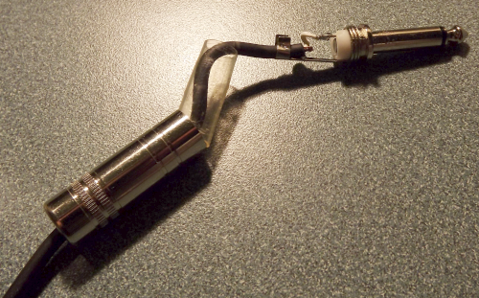
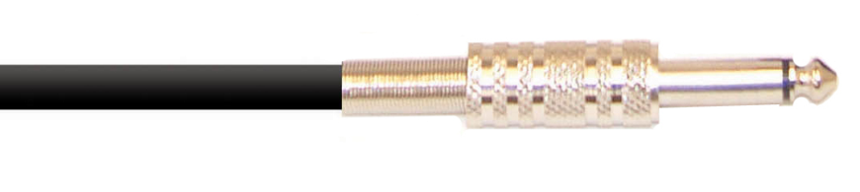
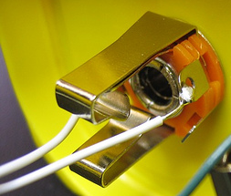
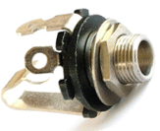
Circuit Interconnection - Unbalanced
C₁
R₁
D
single signal connector with shield
input
G
C₂
S
R₂
R₃
R_{LOAD}
0V

Slide 28
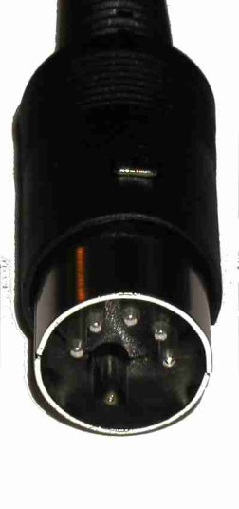
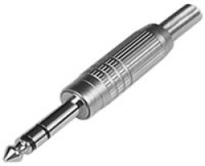
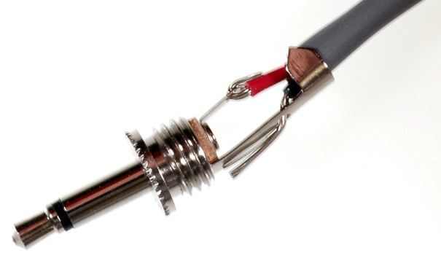
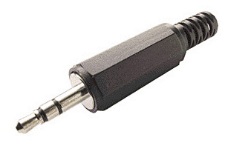
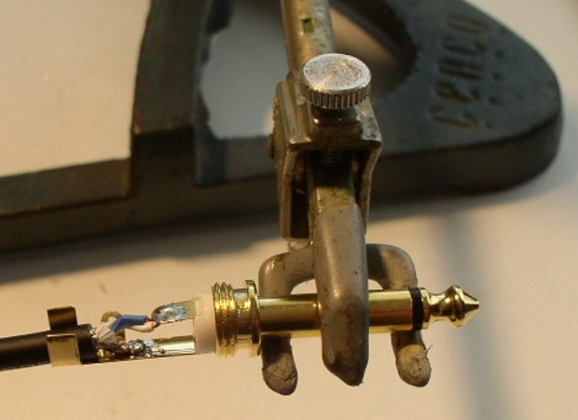
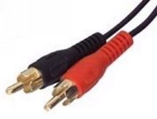
Other Plugs for Unbalanced Connections
mono 3.5mm jack
stereo ¼” jack
5 pin DIN plug
stereo 3.5mm jack
wiring a mono ¼” jack
two mono phono jacks (for stereo)
note the heat dissipation precautions

Slide 29
Circuits – Unbalanced Connection
C₁
R₁
D
input
G
C₂
S
R₂
R₃
R_{LOAD}
shielded cable
0V
These interconnects (shown up to here) are unbalanced
i.e. signal on one lead; the return path is via the shield / 0V / earth lead
Prone to noise, especially as length increases
This is sufficient for domestic audio equipment (short distances, less demanding than professional applications)
For longer signal runs (stage work, event recordings, broadcast, etc) – need more robust signal protection ...

Slide 30
Ground Loops
noise often traced to ground loops, grounding or lack of...
loops occur when the grounds of the two units are also tied together in another place
connections often (inadvertantly) earth the circuit in more than one place, causes loops
C₁
R₁
D
input
G
C₂
S
R₂
R₃
R_{LOAD}
shielded cable
0V
Complete electrical circuit within the earth section – because there is often a small resistive part of the circuit to ground (more in UG2)

Slide 31
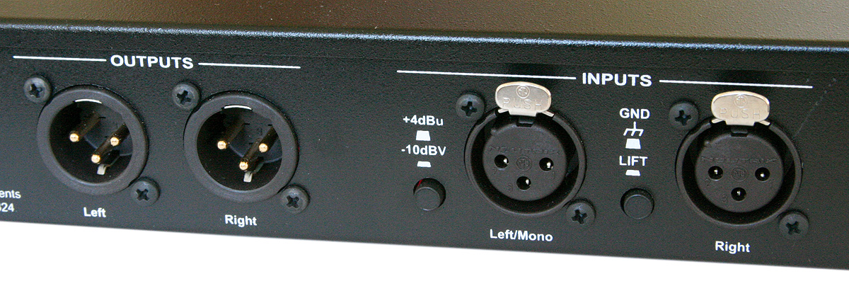
Ground Loops – Ground Lift
should be Ok on professional equipment
… but always beware the safety aspects!!!

Slide 32
Professional Audio Signal Interconnects
Via a balanced line
two signal conductors
plus earth shielding
Uses circuitry to convert ...
single-ended (unbalanced) line → balanced line → input to circuit
... achieved by
transformer circuit
passive – no amplifier – no induced noise
op-amp (electronic circuit)
could introduce noise in op-amp electronics
... (considering we are aiming to eliminate noise in the first place ...)

Slide 33
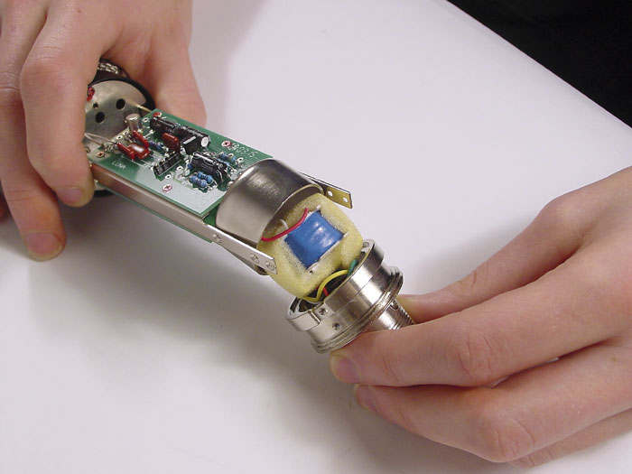
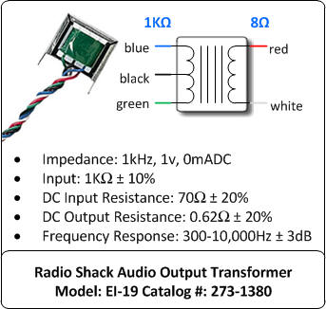
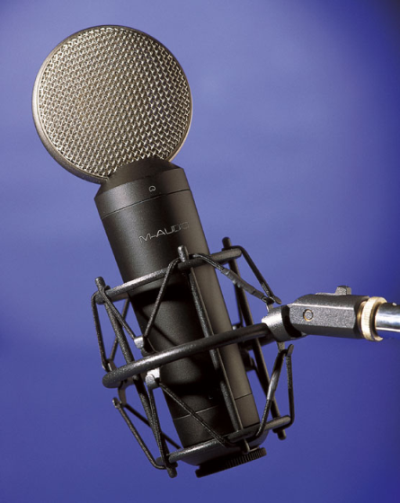
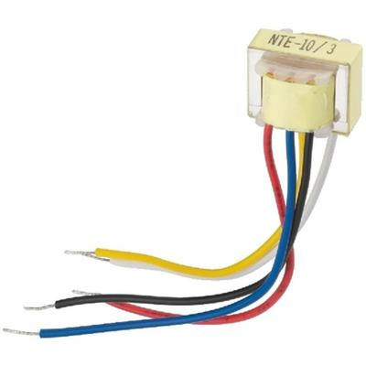
Audio
Transformer
M Audio Luna
Capacitor mic

Slide 34
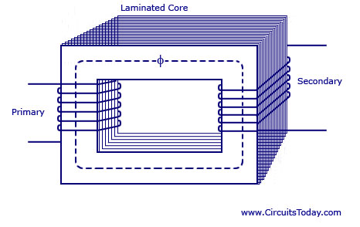
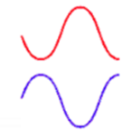
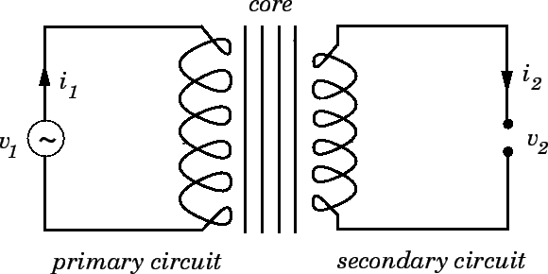
Transformer
4
2
1
3
5
voltage out
voltage in
6
Voltage in to primary winding
induces a magnetic field
magnetic field strength is relative to the input signal
magnetic field induces voltage in secondary winding
… voltage out
V_{out} depends on numbers of windings Primary:Secondary
Circuit schematic

Slide 35
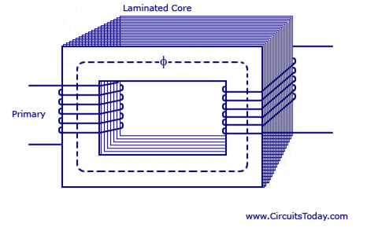
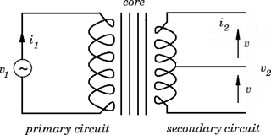
Transformer
voltage out
divided by “tap”
voltage in
Circuit schematic

Slide 36
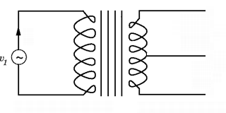
Transformer – Centre Tapped, Earthed
Input signal – at an instant when it reaches (e.g.) 5V …
+5V
+2.5V
-2.5V
Output signal is divided to reach peaks of:
+2.5V
-2.5V

Slide 37
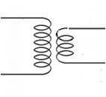
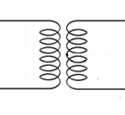

Transformer
turns ratio = 1:1
turns ratio = 2:1
V_{in}
V_{in}
V_{out} = V_{in}
e.g. 240V in ... 120 V out
For an Audio Transformer:
“centre tapped”
(and connected to earth)
turns ratio = 1:1
V_{out+} = V_{in}/2
V_{in}
differential voltage
V_{out-} = -V_{in}/2
one side earthed, forms a shield for the other side
i.e. these are connected together through earth

Slide 38



Balanced Line – Transformer Circuit
http://www.phoenixcomputerlabs.com/All-About-Mixers/Ballanced-Audio.html
audio transformer – or other suitable circuit to derive the differential signal voltage
Unbalanced “single ended” source is converted to balanced signal
e.g. via transformer
Signal is conveyed in a go/return normal/inverted circuit
two lines are out of phase with each other
ground noise (power line hum and buzz) and other interference imposed on one line is cancelled on the other
transformer at load-end converts back to single ended
cable signals are twisted together – further immunity to EM radiation
signal conductors have equal impedances to ground

Slide 39

Balanced Line – Semiconductor Circuit
Unbalanced “single ended” source is converted to balanced signal
e.g. via op-amp circuit
Signal is conveyed in a go/return normal/inverted circuit
two lines are out of phase with each other
ground noise (power line hum and buzz) and other interference imposed on one line is cancelled on the other
op-amp circuit at load-end converts back to single ended
cable signals are twisted together – further immunity to EM radiation
signal conductors have equal impedances to ground

Slide 40
Balance Line Signal Voltages
+V
+48V
“Single-ended”
signal
Balanced Line signals are differential:
equal and opposite on each of the two lines (“hot and “cold”)
-V

Slide 41
Balanced Line
Differential signal
Voltage difference between the two wires
Voltage difference between the two wires
=

Slide 42

Balanced Line
The signal is carried as a differential signal on two conductors
A third conductor forms the shield
0 volts
Shield provides noise immunity
... any noise which does affect the signal will affect both signal conductors equal and opposite, and will be eradicated at the receiving transformer
Audio transformer

Slide 43
Balanced Line (will be explained further in UG2)
http://www.phoenixcomputerlabs.com/All-About-Mixers/Ballanced-Audio.html
audio transformer – or other suitable circuit to derive the differential signal voltage
Unbalanced “single ended” source is converted to balanced signal
e.g. via transformer
Signal is conveyed in a go/return normal/inverted circuit
two lines are out of phase with each other
ground noise (power line hum and buzz) and other interference imposed on one line is cancelled on the other
transformer at load-end converts back to single ended
cable signals are twisted together – further immunity to EM radiation
signal conductors have equal impedances to ground

Slide 44


Balanced / Unbalanced - Comparison of Noise Performance

Slide 45





Balanced Line Connectors
Pin | Function
1 | chassis ground (cable shield)
2 | positive polarity terminal ("hot")
3 | return terminal ("cold")

Slide 46



Phantom Power
Microphone signal and DV voltage supply are supported on the two connectors between the microphone and the mixer
signal transfer
ground
DC voltage transfer
48V supply from mixer
48V to power condenser mic

Slide 47
Phantom Power
ground
48V imposed on conductors
48V available for use at microphone,
but the voltage isn’t transferred in to the signal path at the microphone

Slide 48
Phantom Power
x
DC voltage is not transferred with signal beyond the transformer
x
Signal is transferred
Signal is transferred
ground
volts
48
Signal is conveyed at a constant 48V dc level, so not affected
0

Slide 49



Phantom Power – DV Voltages to Feed the Microphone
Power is often required to (e.g.) condenser microphones
DC voltage is applied to the balanced cable without being transferred to the microphone
The signals on the cable are merely superimposed over the (stable) phantom voltage
Typical voltage = 48V, resistors typically 6.8kΩ, within 0.4% of each other.
0 Volts
+48 Volts
http://neatcircuits.com/audio/phantom.htm

Slide 50
Phantom Power – The Signal Path
Power is often required to (e.g.) condenser microphones
DC voltage is applied to the balanced cable without being transferred to the microphone
The signals on the cable are merely superimposed over the (stable) phantom voltage
Typical voltage = 48V, resistors typically 6.8kΩ, within 0.4% of each other.
http://neatcircuits.com/audio/phantom.htm

Slide 51
Phantom Power – Signal Voltage Levels
+V
+48V
+0V
balanced line signals lifted 48V on phantom power along the two connectors
“single-ended” signal
“single-ended” voltage recovered at the mixer end
-V
normal balanced line signals (i.e. not phantom powered)

Slide 52

Serial Digital Interface
Family of interfaces
SMPTE ITU-R BT.656, SMPTE 259M - broadcast-grade video
HD-SDI - SMPTE 292M - nominal data rate = 1.485 Gb/s
Recent interfaces for
HD, UHD, higher frame rates, 3D, increased color depth
Dual link HD-SDI
pair of SMPTE 292M links (SMPTE 372M) = 2.970 Gbs
digital cinema
HDTV 1080P
Uncompressed, unencrypted digital video
may include embedded audio + time code
also for packetized data
SDI and HD-SDI usually only in professional video
due to licensing restrictions of unencrypted digital interfaces
alternative - consumer cameras - HDMI

Slide 53


Serial Digital Interface
NRZI
bit = 1, the signal changes state after the clock tick.
bit = 0, the signal does not change state.
Electrical / Physical
coaxial cables, BNC connectors
nominal impedance of 75Ω
signal amplitude at source = 800 mV (±10%) p-p
270 Mbs SDI over 300 m; but shorter lengths preferred
length of transmission typically <300 m
fibre variants - eg 297M for long-distance transmission
HD bitrates - typically 100 meters
http://ccm.net/contents/703-data-transmission-digital-data-transmission
Uncompressed digital component signals
NRZI format
data scrambled to reduce long strings of 0's and 1's
self-synchronizing and self-clocking
SMPTE 2022
digital video over IP network, includes MPEG-2 (systems) and SDI

Slide 54
Serial Digital Interface
Data Format
SD: 10b samples
HD: 20b: 2 x 10-bit datastreams (10b Y then 10b C)
Datastream
color encoding 4:2:2 YCbCr
SD: … Cb Y Cr Y' Cb Y Cr Y’ …
HD: … Luma - Y Y' Y Y' Y Y' Y Y’ … Chroma - Cb Cr Cb Cr Cb Cr Cb Cr
luminance channel (Y)
full bandwidth (13.5 MHz @ 270 Mbit/s SD; ~75 MHz HD)
chrominance channels (Cb and Cr)
subsampled horizontally, encoded at half bandwidth
(SD: 6.75 MHz or HD: 37.5 MHz).
Y, Cr, and Cb samples are co-sited - acquired at the same instance in time
Y' sample - acquired halfway between two adjacent Y samples
Video payload
10b word: 4 to 1,019
0–3 and 1,020–1,023 reserved - Synchronization, Ancillary data

Slide 55
Serial Digital Interface
Line counter and CRC
add additional check words
HD: CRC field = CRC of the preceding line
.. computed independently for the Y and C streams
Line and sample numbering
Each sample within a datastream is assigned a unique line and sample number
Lines numbered sequentially
starting from 1, up to the number of lines per frame of the indicated format
… typically 525, 625, 750 (1125 for Sony HDVS)
Link numbering - for multi-link interfaces
first link - the primary link - link number = 1
subsequent links are assigned increasing link numbers

Slide 56




AES 3
AES/EBU
digital audio signals
two channels PCM audio
balanced lines, unbalanced lines, and optical fiber
1985, revised in 1992 and 2003
IEC 60958 Type I—Balanced, XLR
3-conductor, 110-ohm twisted pair
professional installations
IEC 60958 Type II—Unbalanced, RCA
unbalanced, 2-conductor, 75-ohm coax, RCA connectors (phono)
consumer, coaxial S/PDIF
IEC 60958 Type III Optical—Fiber, F05/TOSLINK
optical fiber, typ plastic
Toshiba brand name, TOSLINK
consumer, optical S/PDIF
AES-3id
75-ohm BNC electrical variant of AES3
analogue or digital video
common in the broadcast industry

Slide 57


AES 3 Framing
Audio Block
Frame 0
Frame 1
Frame 191
TS0
TS1
TS31
subframes:
when sample is 20bit coded …

Slide 58
Media Technology, Moving Image Technology UG1
16:
Signals, Balanced Lines, Impedance
Jerry Foss
jeremy.foss@bcu.ac.uk

Slide 59
additional

Slide 60
Multistages
Much gain is required to lift an input signal to a level suitable for driving speakers, especially for high power PA systems
This will often be implemented by several different units
… preamplifiers, equalisers, mixing, processing stages, etc
The earlier stages may have little power amplification – they are mainly concerned with effects, processing, EQ, etc
However, where pure amplification is needed the signal may need many stages of amplification.
Theoretically, for noise considerations it is better to have as much gain as possible (e.g. without distortion, etc) in the early stage(s)
e.g. if a gain of 1000 is required, two stages may be needed:
V_{in}
V_{out}
x100
x10

Slide 61
Impedance
Amplifier
equipment looking into the amplifier output (e.g. speakers) will “see” the output impedance
equipment
looking into the amplifier input (e.g. microphone) will “see” the input impedance
Z_{in}
Z_{out}
input impedance = Z_{in}
output impedance = Z_{out}
Impedance is resistance, but includes reactance (capacitive and inductive resistance)
∴ can vary with frequency (because X_{C} and X_{L} does)
an important consideration when coupling equipment together
impedance matching enables maximum power transfer between devices
denoted as Z, and expressed in ohms (Ω)

Slide 62
Impedance
Amplifier
equipment looking into the amplifier output (e.g. speakers) will “see” the output impedance
equipment
looking into the amplifier input (e.g. microphone) will “see” the input impedance
Z_{in}
Z_{out}
input impedance = Z_{in}
input impedance = Z_{out}
impedance is unavoidable, so the circuit must be designed to manufacture a favourable impedance figure
impedance values are often standardised to allow equipment to work together
e.g. common impedance for loudspeaker systems is 8Ω

Slide 63
Impedance
A voltage source (e.g. microphone) feeds into an amplifier
Source
Amplifier
Z_{out}
Z_{in}
Z_{out}
Consider the impedances connected together as a potential divider circuit:
Here, to maximise power transfer, Z_{out} should be as low as possible;
Z_{in} should be high as possible
This means the amp input is (virtually) higher towards the top of the divider circuit, so more signal is delivered, rather than being lost in Z_{out}
If Z_{in} is very low, it is virtually a short circuit, and the signal would be shunted down to earth (or 0V)
Source
Z_{out}
Amplifier
Z_{in}
However, must also consider the connecting cable, especially long mic cables

Slide 64


Slide 65
INDUCTANCE

Slide 66

(Not Capacitors …)
Inductors and Inductance
Filters: Crossover networks – Bass, Treble
Timing
Mains interference suppression
Radio Frequency / station tuning
Inductance is denoted by “L”
Inductive Reactance is X_{L} (c.f. Capacitive Reactance = X_{C})
X_{L} (Ω)
f (Hz)

Slide 67

Capacitor and Inductor – when DC voltage is applied
C
L
R
R
v, i
Voltage rises to maximum
v, i
Current rises to maximum
Current falls to zero
Voltage falls to zero
t
t
for further detail – see http://www.opamp-electronics.com/tutorials

Slide 68
IMPEDANCE

Slide 69
Impedance
Amplifier
equipment looking into the amplifier output (e.g. speakers) will “see” the output impedance
equipment
looking into the amplifier input (e.g. microphone) will “see” the input impedance
Z_{in}
Z_{out}
input impedance = Z_{in}
output impedance = Z_{out}
Impedance is resistance, but includes reactance (capacitive and inductive resistance)
∴ can vary with frequency (because X_{C} and X_{L} does)
an important consideration when coupling equipment together
impedance matching enables maximum power transfer between devices
denoted as Z, and expressed in ohms (Ω)

Slide 70
Impedance
Amplifier
equipment looking into the amplifier output (e.g. speakers) will “see” the output impedance
equipment
looking into the amplifier input (e.g. microphone) will “see” the input impedance
Z_{in}
Z_{out}
input impedance = Z_{in}
input impedance = Z_{out}
impedance is unavoidable, so the circuit must be designed to manufacture a favourable impedance figure
impedance values are often standardised to allow equipment to work together
e.g. common impedance for loudspeaker systems is 8Ω

Slide 71
Impedance Bridging – to transfer maximum voltage
A voltage source (e.g. microphone) feeds into an amplifier
Source
Amplifier
Z_{out}
Z_{in}
Z_{out}
Consider the impedances connected together as a potential divider circuit:
Here, to maximise power transfer, Z_{out} should be as low as possible;
Z_{in} should be high as possible
This means the amp input is (virtually) higher towards the top of the divider circuit, so more signal is delivered, rather than being lost in Z_{out}
If Z_{in} is very low, it is virtually a short circuit, and the signal would be shunted down to earth (or 0V)
Source
Z_{out}
Amplifier
Z_{in}
However, must also consider the connecting cable, especially long mic cables

Slide 72
Further Impedance Issues:
Need to consider reactive components
current and voltage phase
calculation and representation of phase vectors

Slide 73


Reactance – Phase Difference between Voltage and Current
http://www.ngsir.netfirms.com/englishhtm/RC_dc.htm
See applet – shows capacitor charging
Initial voltage across C is zero
Initial current flowing is maximum
Voltage increases to maximum
current reduces to zero

Slide 74
Capacitor and Inductor – when DC voltage is applied
C
L
R
R
v, i
Voltage rises to maximum
v, i
Current rises to maximum
Current falls to zero
Voltage falls to zero
t
t
for further detail – see http://www.opamp-electronics.com/tutorials

Slide 75



Resistance – to AC Signal
Pure resistive
current (i) and voltage (e) are in phase
power also in phase
when i and e both +ve; p is +ve
since p=i x e ...
when i and e both -ve; p is still +ve

Slide 76



Inductor Reactance to AC signal
voltage is applied to inductor, but due to the windings of the inductor, self-inductance occurs which forma a current which opposes the applied current
The over all effect is that the resulting current lags the voltage applied by 90º
Inductive
Because instantaneous power p=i x e
p =0 whenever i=0 or e=0
when i and e are both +ve power is positive
when i and e are both -ve power is still positive
However, since i and e are now 90º out of phase, there are times when one is positive while the other is negative
resulting in equally frequent occurrences of negative instantaneous power

Slide 77



Capacitor Reactance to AC signal
For a capacitor, the ac voltage lags the current by 90º

Slide 78



Impedance – Resistive and Reactive

Slide 79

Impedance – Resistive and Reactive
Impedance phase angle for any component is the phase shift between voltage across that component and current through that component.
For a perfect resistor
voltage drop and current are always in phase with each other
∴ impedance angle of a resistor = 0º
For an perfect inductor
voltage drop always leads current by 90º
∴ inductor's impedance phase angle = +90º
For a perfect capacitor
voltage drop always lags current by 90º
∴ capacitor's impedance phase angle = -90º.

Slide 80

Phase

Slide 81

Phase

Slide 82

Phase - Vectors

Slide 83


Phase - Vectors
0 .. α .. 90
α

Slide 84

Phase – Vectors, j-notation
When dealing with phase in electronic engineering, the “j notation” is adopted for the vertical axis.
j = √-1
numbers relating to j are dealt with in a separate plane, the vertical axis
real numbers are kept on the horizontal plane

Slide 85

Phase – Vectors, j-notation
Consequently Impedance can be represented:
REAL axis – for pure resistance
IMAGINARY (J) axis for Reactance

Slide 86
Impedance – Resistive and Reactive
Impedances in AC behave similar to resistances in DC circuits:
they add in series, they diminish in parallel
A revised version of Ohm's Law, based on impedance rather than resistance, looks like this:
Ohm’s Law for AC circuits
where
E = voltage
I = current
Z = Impedance

Slide 87



Impedance – example - Series R, L, C
Now express all resistances and reactances in a mathematically common form: impedance
an inductive reactance translates into a positive imaginary impedance (or an impedance at +90º)
a capacitive reactance translates into a negative imaginary impedance (impedance at -90º)
Resistance is still regarded as a purely "real" impedance (polar angle of 0º):
cont’d

Slide 88
Impedance – example - Series R, L, C
Z_{C}
Resultant effective Impedance , Z
Phase angle
Z_{L}
Z_{R}

Slide 89


Impedance – example – Parallel R, L, C
≡

Slide 90
Transmission Lines,
Characteristic Impedance

Slide 91

Characteristic Impedance, Z_{c}
Consider an infinitely long transmission line
no reflections from the load
Input (ac) voltage = V_{in}(t); results in current = I_{in}(t)
Impedance of the transmission line is then:
(c.f. Ohm’s Law )
However - no transmission line is infinitely long
I_{in}(t)
V_{in}(t)
∞
I_{in}(t)

Slide 92

Transmission Line
Transmission line lumped element equivalent circuit
∞
Consider general equivalent circuit of an unit section of the transmission line
units of R = Ω/m; C = F/m; G = /m; L = H/m
Each section is repeated infinite times along the length of the transmission line
Telegrapher’s Equation
The general expression that defines characteristic impedance is:
where
j is the “imaginary” component (i.e. reactive phase related)
ω if the angular frequency (i.e. ω =2πf)
"prime" notation to show quantities are normalized per unit length

Slide 93

Transmission Line
in its general form, characteristic impedance can be a complex number
For a low-loss transmission line, the following relationships will occur:
... so we can ignore the contributions of R' and G' from the equation
this results in a scalar quantity for characteristic impedance
So for lossless transmission lines the transmission line model reduces to this:

Slide 94
Transmission Line and Characteristic Impedance
The characteristic impedance (Z₀) of a transmission line is …
… the resistance it would exhibit if it were infinite in length
Characteristic impedance is …
purely a function of the capacitance and inductance distributed along the line's length
it would exist even if the dielectric were perfect (infinite parallel resistance) and the wires had zero series resistance
For example
Coaxial cables - impedance of 50 or 75 Ohms at high frequencies
Twisted-pair cables - impedance of 100 Ohms above 1 MHz
http://www3.eng.cam.ac.uk/DesignOffice/mdp/electric_web/AC/AC_14.html

Slide 95
Transmission Line and Characteristic Impedance
Characteristic impedance is of prime importance for good transmission
Maximum power transfer occurs when the source has the same impedance as the load
Thus for sending signals over a line, the transmitting equipment must have the same characteristic impedance as the line to get the maximum signal into the line
Receiving equipment must also have the same impedance as the line to be able to get the maximum signal out of the line.
Where impedances do not match, some of the signal is reflected back towards the source
Usually - the reflected signal causes problems - therefore undesirable.

Slide 96


Transmission Line and Characteristic Impedance
Consider …
An incident waveform
… is reflected when it reaches the unterminated end
… sum the two waveforms together
… a stationary waveform is created along the line's length:

Slide 97
Transmission Line and Characteristic Impedance
Reflections may be eliminated from the transmission line if the load's impedance exactly equals the characteristic impedance of the line
For example: 50 Ω coaxial cable that is either open-circuited or short-circuited will reflect all of the incident energy back to the source
However, if a 50 Ω resistor is connected at the end of the cable, there will be no reflected energy, all signal energy being dissipated by the resistor
Reflected waves will occur if R _{terminating} ≠ Z₀
… here, energy reflection will partial
Reflected waves may be re-reflected from the source (simulating a separate transmission of a signal)
So if: R _{terminating} = Z₀
line appears infinitely long from the perspective of the source
… (because R _{terminating} dissipates the energy in the same way a transmission line of infinite length is able to eternally absorb energy

Slide 98
Transmission Line and Characteristic Impedance
The practical implications of L' and C'
L' is the tendency of a transmission line to oppose a change in current
C' is the tendency of a transmission line to oppose a change in voltage
Characteristic Impedance
... is a measure of the balance between the two
Prime (‘) … because these are quantities per unit length
(lumped parameters)
Typically - characteristic impedance has resistive and reactive component
It is a function of the frequency of the applied signal, and is unrelated to length
At very high frequencies, the characteristic impedance asymptotes to a fixed value which is resistive
Z_{c ,}Ω
f, Hz

Slide 99
Transmission Line and Characteristic Impedance
For twisted pair and coaxial cables:
resistance is determined by the diameter or weight of copper
inductance (L) is very small
shunt conductance (G) is small
The major influence on characteristic impedance is the capacitance (C)
This is largely determined by the type of insulation (dielectric) used.

Slide 100
Transmission Line and Characteristic Impedance
For limited lengths – consider Z₀ as surge impedance
i.e. a transient voltage applied to one end
from I=E/Z the line will draw a current:
If the end is open-circuited, the current "wave" will stop at the end
… since electrons cannot flow any further
causes a "pile-up" of electrons, backing up the line
"pile-up" propagates back to the supply/signal
- ceases to drive for electrons … and the line acts as a simple open circuit
… this relationship will for a limited period of time, but not indefinitely …
I_{in}(t)
V_{in}(t)
e
e
e
e
e
e
e
e
e
e
e
e
e
e
e
e
e
e
e
I_{in}(t)
V_{in}(t)
e
e
e
e
e
e
e
e
e
e
e
e
e
e
e
e
e
e
e
e
e
e
e
e
e
e
e
e
e
e
e
e
e
e
e
e
e
e
e
e
e
e
e
e
e
e
e
e
e
e
e
e
e
e
e
e
e
e
e
e
e
e
e
e

Slide 101
I_{in}(t)
V_{in}(t)
e
e
e
e
e
e
e
e
e
e
e
e
e
e
e
e
e
e
e
e
e
e
e
e
e
e
e
e
e
e
e
e
e
e
e
e
e
e
e
e
e
e
e
e
e
e
e
e
e
e
e
e
e
e
e
e
e
e
e
e
e
e
e
e

Slide 102


Slide 103


Slide 104


Slide 105
Slide Title
text text text
no text refit
Bullets
bullets
bullets
bullets
caption … caption … caption .. caption .. caption caption . caption . caption caption caption

